Slide 1
Bio Innovation of a Circular Economy for Plastics AIMPLAS Pablo Ferrero
H2020-NMBP- BIO-CN-2019 CE-BIOTEC-05-2016-870292 –BIOICEP
Meeting Month 01 AIT-Athlone 10/02/2020

Slide 2
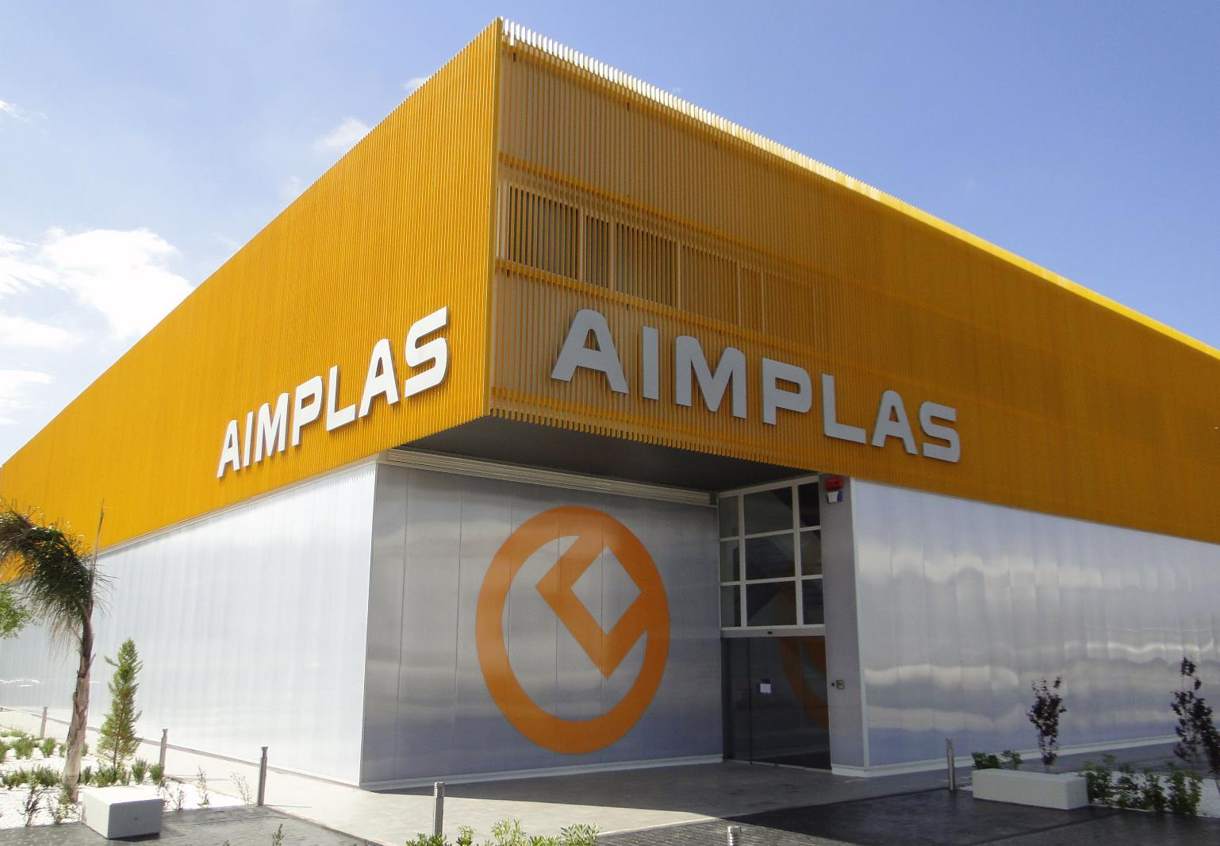
AIMPLAS
What is AIMPLAS?
A technology centre with more than 25 years’ experience in the plastic sector.
Our Mission
Add value to companies to generate wealth and create employment.
Add value to society to improve quality of life and ensure environmental sustainability.

Slide 3
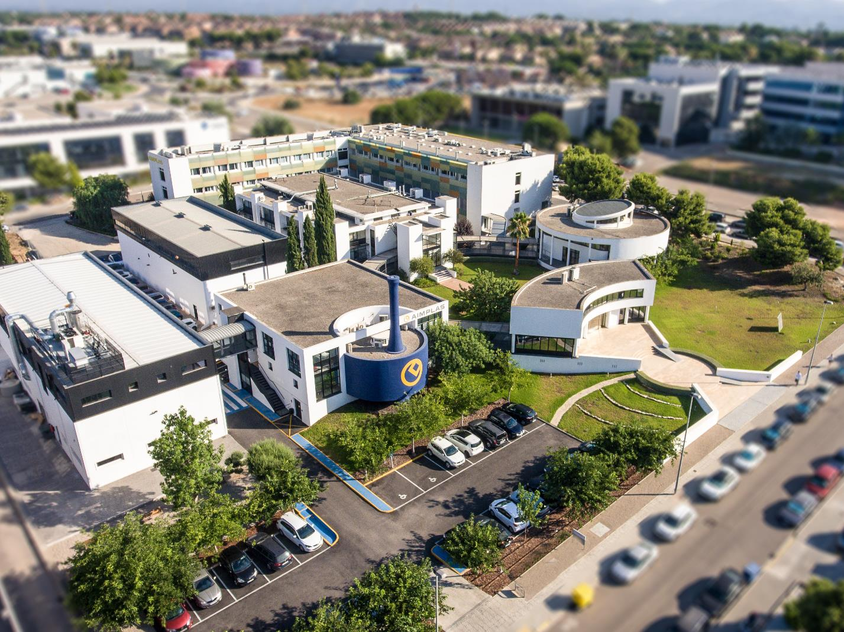
AIMPLAS
More than 9,000 m² of cutting-edge facilities
Pilot plants (5,000 m²)
Laboratories (4,000 m²)

Slide 4
Polymer
synthesis
Raw
materials
Expertise across the entire plastics value chain
Recovery of plastic waste
Compounding
End users
Manufacturing /
Processing

Slide 5
Role in the project
Summary of staff effort
Partic. No | Partic. Short name | WP1 | WP2 | WP3 | WP4 | WP5 | WP6 | WP7 | WP8 | Total PM
1 | AIT | 40 | 24 | 0 | 6 | 6 | 8 | 8 | 13 | 105
2 | ACT | 0,5 | 6 | 0 | 0 | 0 | 0 | 4 | 2 | 12,5
3 | AIM | 3 | 38 | 0 | 0 | 0 | 14 | 6 | 24 | 85
4 | AVE | 2 | 0 | 3 | 0 | 12 | 4 | 20 | 0 | 41
5 | CUT | 2 | 9 | 0 | 12 | 0 | 0 | 0 | 2 | 25
6 | IMGGE | 4 | 1 | 100 | 6 | 6 | 12 | 9 | 2 | 140
7 | IEBT | 2 | 0 | 3 | 0 | 4 | 56 | 14 | 2 | 81
8 | LIT | 2 | 0 | 0 | 56 | 10 | 0 | 0 | 4 | 72
9 | LOG | 1 | 4 | 0 | 0 | 0 | 23 | 0 | 2 | 30
10 | MLS | 2 | 0 | 8 | 8 | 18 | 2 | 0 | 0 | 38
11 | NTUA | 2 | 0 | 19 | 8 | 7 | 0 | 0 | 2 | 38
12 | TCD | 2 | 38 | 0 | 0 | 0 | 7 | 5 | 2 | 54
13 | BIT | 2 | 0 | 0 | 36 | 36 | 0 | 24 | 10 | 108
14 | SDU | 3 | 0 | 24 | 12 | 18 | 36 | 0 | 6 | 99
15 | CAS | 2 | 0 | 0 | 20 | 60 | 0 | 10 | 6 | 98

Slide 6
WP 2: Pre-Treatment Processes for Plastic
Bio-Degradation
Leader: TCD
Task 2.1 Formulating and analyzing of plastic waste feedstock
Task 2.2 Evaluation of pre-treatment technologies (Contributor)
Task 2.2.1 Ultrasonication
Task 2.2.2 Microwave thermal degradation (Leader)
Task 2.2.3 Supercritical Carbon dioxide assisted depolymerization (Leader)
Task 2.2.4 Reactive extrusion (Leader)
Task 2.2.5 UV-degradation
Task 2.2.6 Blending with natural polymers and additives (Contributor)
Task 2.3 Evaluation: Identification of pre-treated plastic compounds as a compatibilizer for polymer blends suitable 3D printing
Task 2.4 Characterization of the pre-treated plastics and degradation products isolated
Task 2.5 Optimisation of the Pre-treatment process (Contributor)

Slide 7
WP 6: Bioprocess Development for Production
of Value-added Biopolymer Products
Leader: IEBT
Task 6.1 Bioprocess optimization (Laboratory scale) (Contributor)
Task 6.2 Process validation at 10 L reactor (Laboratory scale)
Task 6.3 Metabolic modelling and bioprocess design
Task 6.4 Development and optimization of downstream procedures for products’ recovery
Task 6.5 Chemical, mechanical, and thermal characterization and analysis (Contributor)

Slide 8
WP 7: Establishment BioICEP Pilot Plant for mixed plastics degradation and bioproduct production
Leader: AVE
Task 7.1 Construction of Pilot reactor according to specification input from WP2, 3, 4 and 5
Task 7.2 Pilot reactor setup (Contributor)
Task 7.3 Pilot reactor operation
Task 7.4 Monitoring of pilot reactor operation and production process
Task 7.5 Extensive chemical, mechanical, thermal and aging characterization and analysis
Task 7.6 Demonstration of pilot production of PHB and nanocellulose for thin biopolymer film production for applications such as food packaging and rhamnolipids for pharmaceutical products (Contributor)
Task 7.7 Life cycle analysis of BioICEP technology and products (Contributor)

Slide 9
WP 8: Dissemination, Exploitation, and Communication
Leader: AIM
Task 8.1 Communication & stakeholder engagement strategy (M1-M48) (Leader)
Task 8.2 Dissemination activities (M1 – M48) (Leader)
Task 8.3 Exploitation, innovation and IPR management (M1 – M48) (Leader)
Task 8.4 Industry engagement strategy (Contributor)
Task 8.5 Business model development (Contributor)

Slide 10
Thank you!
pferrero@aimplas.es
pferrer@aimplas.es
https://www.aimplas.es/

